Slide 1

JOB ANALYTICS
Prepared By:-
Ayush Khetan
Samrudh Samarth
Daksh Kayat

Slide 2
Introduction
Scrape data from the professional networking platform LinkedIn using a python library called Beautiful soup (or similar), collate information in the given format, and make 3 tables using the data. We have to scrap the data from the website after that we have to analyze the data that we scrap out of the LinkedIn webpage and make the insights out of the data in the form of visuals and graphs.

Slide 3
Problem statement
Generate different insights from data such as:
Comparison of the number of jobs across different cities for different levels.
Number of jobs distribution across various industries.
Number of openings with respect to the current employee count - Number of openings in a company with more than 1000 employees in comparison to the number of openings in a company with 100 employees.
Generate some interesting insight from the data.

Slide 4
TOOLS USED
● PYTHON
● MS SQL SERVER
● EXCEL
● Tableau

Slide 5





Execution of project PLAN
Data scraping
Data cleaning
SQL
Use excel.
Graphical
representation
Scraping of data from LinkedIn by using python Library
Removal of NAN values & Noise cleaning
Use SQL to find out the insights of the data.
Using of excel pivot table for finding out the insights.
Making visualizations from the insights derived

Slide 6
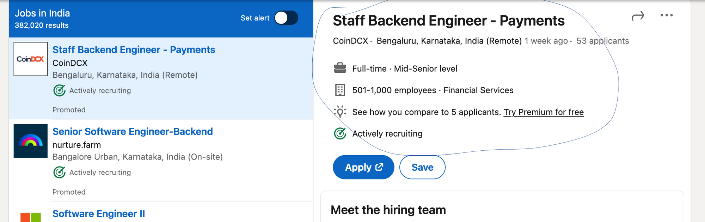
data we scrap out from LinkedIn?
Job designation, Location, Company, No. of Employees, Industry, Linkedin followers, No. of applicants, Involvement, Level of Job.

Slide 7
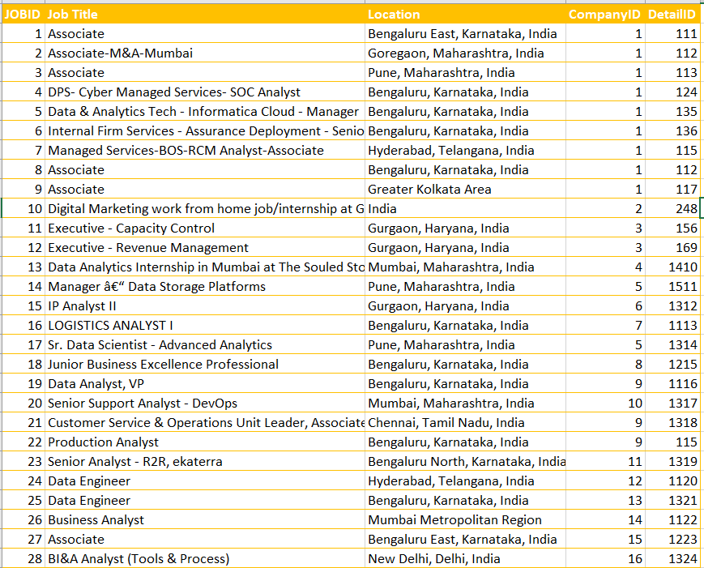
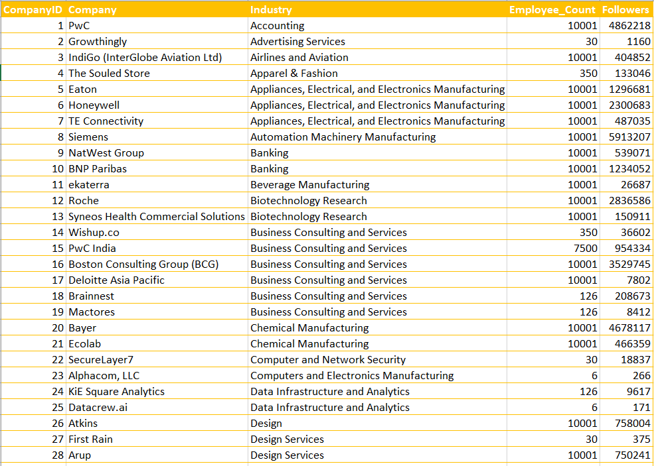
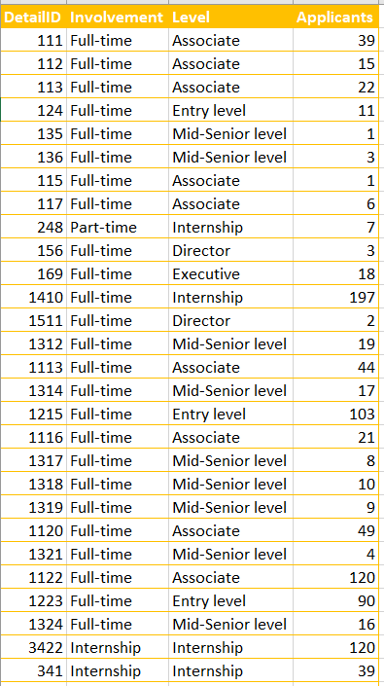
JOBS TABLE
COMPANY TABLE
DETAILS TABLE

Slide 8
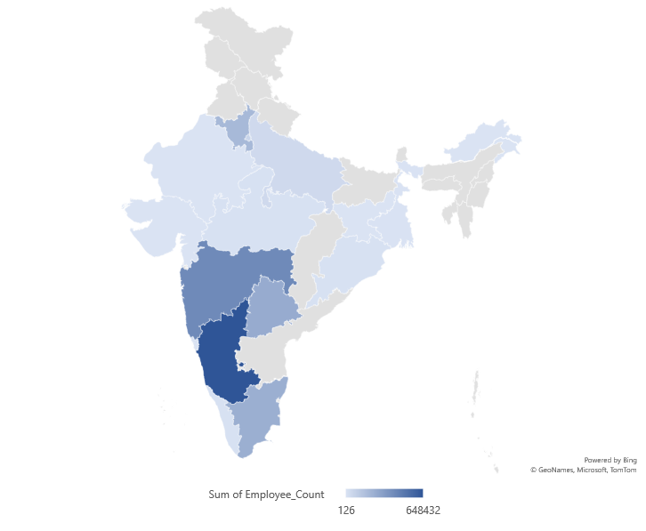
In North India, Haryana is the highest job-providing state.
In Central India, Maharashtra highest job-providing state.
In the South, Karnataka highest job providing state.

Slide 9
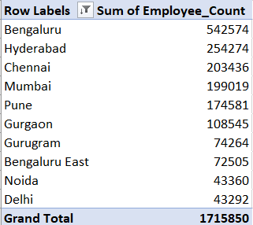
TOP 10 EMPLOYMENT LOCATION BASED ON THE NUMBER OF EMPLOYEES

Slide 10
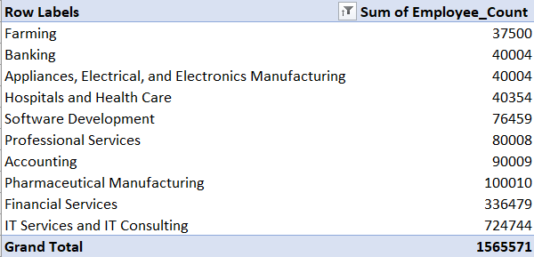
TOP 10 INDUSTRIES BASED ON EMPLOYEES COUNT
* IT Services and IT Consulting is the leading Industry in terms of Employee counts.

Slide 11
Comparison of the number of jobs across different cities for different level jobs
Mid-Senior Level & Entry Level jobs are highest in different locations in LinkedIn Job search

Slide 12
Jobs Openings at Different Job Levels
Mid-Senior level jobs are the highest followed by Entry level and Associate level.

Slide 13
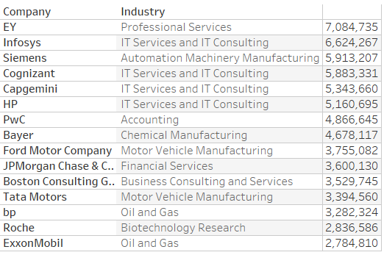
Popular company among LinkedIn Users
* Professional Services industry is leading in terms of no. of followers. That shows the interest in the Professional Services for jobs is high.
* IT Services and IT Consulting Industry is in 2nd spot, followed by the Automation Machinery Manufacturing industry.

Slide 14
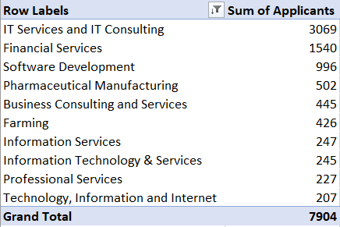
Top 10 Industry in terms of no. applicants
No. of applicants in IT services is highest followed by Financial Services & Software Development Industry.
This shows the interest of applicants in IT companies.

Slide 15
EMPLOYEES INVOLVEMENT
Full-Time job involvement is the highest. Around 96% of jobs role are of Full-Time involvement.

Slide 16
Jobs Openings on the basis of company size.
Companies with more than 1000 Employees are contributing 68% in terms of Jobs opening.
Companies with 100 - 1000 Employees range are contributing 20% in terms of Job openings.
Companies within 100 Employees are contributing 12% in terms of Jobs opening.

Slide 17
List of cities that are leading in various industry Industries.
Industry | City
Appliances, Electrical, and Electronics Manufacturing | Pune
Transportation, Logistics, Supply Chain and Storage | Bangalore
Accounting | Bangalore
Airlines and Aviation | Delhi
Automation Machinery Manufacturing | Bangalore
Aviation and Aerospace Component Manufacturing | New Delhi
Banking | Chennai
Biotechnology Research | Bangalore
Chemical Manufacturing | Bangalore
Civil Engineering | Gurgaon
Computers and Electronics Manufacturing | Gurgaon
E-Learning Providers | Bangalore
Executive Offices | Hyderabad
Food and Beverage Manufacturing | Imamganj
Food and Beverage Services | Bangalore
Hospitality | Gurgaon
Hospitals and Health Care | Gurgaon
Industrial Machinery Manufacturing | Bangalore
Information Services | Bangalore
Insurance | Bangalore
Machinery Manufacturing | Bangalore
Market Research | Bangalore
Mining | Kolkata
Musicians | Mumbai
Newspaper Publishing | Nagpur
Pharmaceutical Manufacturing | Gurgaon
Professional Services | Bangalore
Rail Transportation | Bangalore
Retail Luxury Goods and Jewelry | Bangalore
Semiconductor Manufacturing | Hyderabad
Telecommunications | Bangalore
Textile Manufacturing | Kalyanpur
Tobacco Manufacturing | New Delhi
Transportation Equipment Manufacturing | Gurgaon
Truck Transportation | Kalyanpur
Wholesale Building Materials | Imamganj
North:- Aviation, Manufacturing, Automobile, Civil Engineering, Computer & Electronics Manufacturing, Pharmaceutical, and Transportation Equipment.
Central:- Music & Entertainment, Newspaper, Semiconductor, FMCG, Mining, Electrical & Electronics Manufacturing, Food.
South:- Information services, Telecom, Machinery Manufacturing, Biotechnology Research, E-Learning, Professional Services, Accounting.

Slide 18
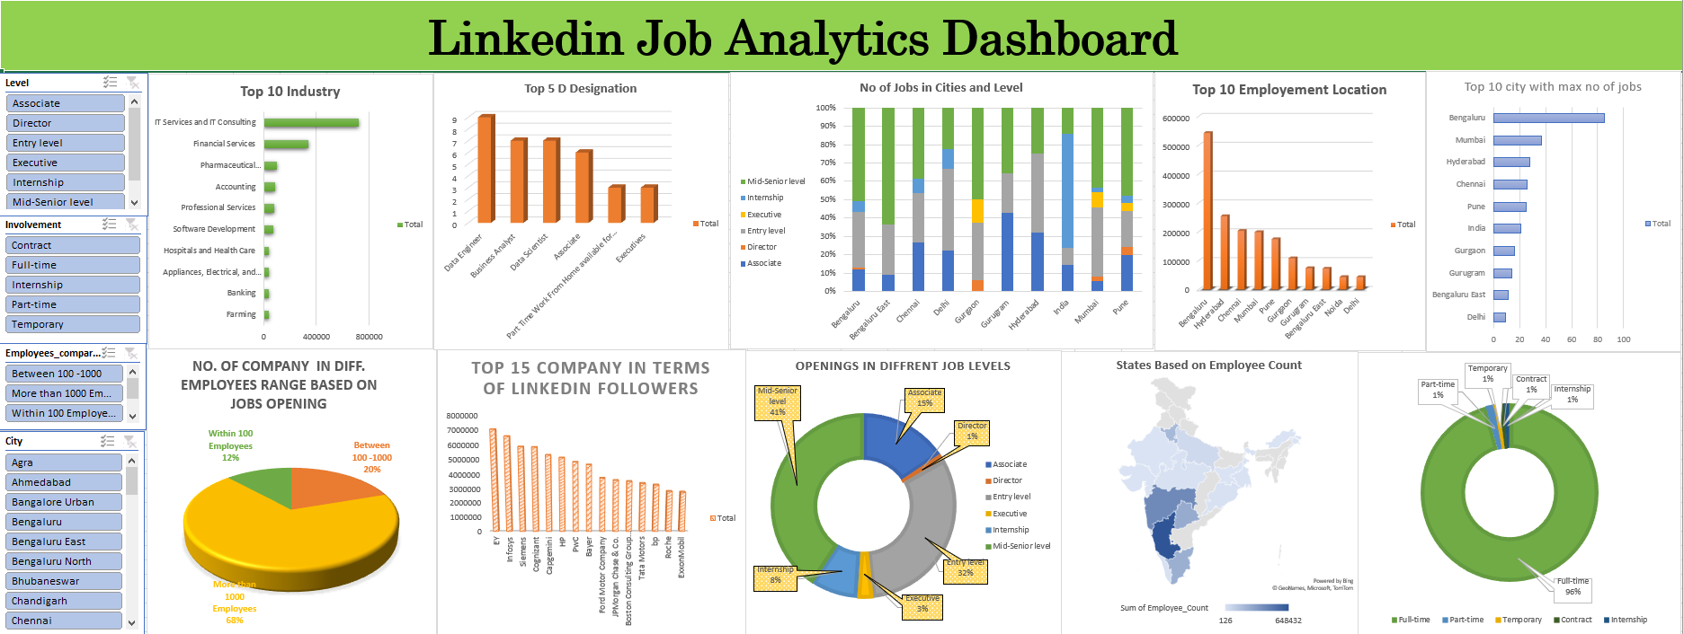

Slide 19
INSIGHTS AND FINDINGS
1. No. of jobs in different industries - IT services and consulting has more number of jobs as compared to marketing
2. No. of jobs in different locations – Karnataka, Maharashtra, and Haryana has more jobs as compared to other locations
3. Number of jobs across the different industries across different locations – Bangalore, has the most number of jobs in IT consulting and services
4. Top 10 companies with max no of applicants – Appen, American Express, Amazon, Motorola Solutions, nanosystems consulting Pvt ltd, Procol, TransPerfect, amazon web services.
5. Company has more no. of followers – EY has the most number of followers
6. Comparison between the office and remote jobs – Office has 90 % of jobs and remote has only 10 % of jobs.
7. Top 10 demanding jobs – Data Analyst, Search Analyst, Software Development Engineer, Voice Analyst, Social Media Analyst, Solutions ConsultantUS Region, Software Engineer I, Trainee Software Engineer, Social Media Analyst, Marketing Executive.

Slide 20
Learning
How to scrap data from a web page.
Use of python libraries like BeautifulSoup, and Selenium.
Data Cleaning.
Arranging the data for finding out the insights.
How to work in a team.
Time management.

Slide 21
THANK YOU

